Slide 1
Tempus Project TEMPUS-SMGR 516663-TEMPUS-1-2011-ES
Internationalization in Central Asia and the Eastern Neighbouring Area
(ICAEN)
http://institucional.us.es/tempusicaen/

Slide 2
DISCLAIMER
“Tempus ICAEN® has been funded with support from the European Commission. This presentation reflects the views only of its coordinator, and the Commission cannot be held responsible for any use which may be made of the information contained therein."

Slide 3
BASIC FEATURES OF TEMPUS SM-158887
Tempus IV Project
Budget: € 825.618,34 (89,97%) + co-financing
Grantholder: University of Seville
Coordinator:. Prof.Dr. Miguel Ángel Adame. University of Seville

Slide 4
BASIC FEATURES OF SMGR 516663: PARTNERS
University of Sevilla, Spain
Inholland University of Applied Sciences Heriot-Watt University Haute Ecole Charlemagne Belarus State Economics University Belarusian Trade Economics University of Consumer Cooperatives Tbilisi State University Gori Teaching University Tajik State University of Commerce Tajik Technical University Assoc. Internat. Des ÉTudiants En Sciences ÉConom. Et Commerc. Ministry of Education (Belarus) Ministry of Education And Science (Georgia) Ministry of Education (Tajikistan)

Slide 5
THE UNIVERSITY OF SEVILLE
It is organised into 25 centers + 5 associated centers
123 departments
156 areas of knowledge.
68 bachellor degrees-
124 PhD programmes
60.000 students
4.200 professors
2.300 non teaching staff
6.500 employees.
Total budget over €500,000,000
It has just been named International Campus of Excellence by the Ministry of Education (adding extra €170,000,000)

Slide 6
Project Summary
ICAEN project aims at strenghtening capacities for international cooperation in countries of the Eastern Neighbouring Area and Central Asia in order to contribute to better international networking & exploitation of institutional & national internationalization potentials in the involved regions. Specifically, the project aims at systematic analysis & benchmarking of potentials and development of national recommendations for boosting internationalisation of Teaching, Learning & Research in Belarus, Georgia & Tajikistan. The action further foresees strenghtening of strategic, infrastructural & human capacities in 6 universities as a model for the development & modernisation of institutional management of internationalisation in the three Partner Countries. At the core of the project also lies the development of an international network as a platform for regular dialogue & exploitation of synergies in internationalisation in a multi-regional context. The specific objectives will be realised through carefully planned actions at institutional, national & multi-regional levels including: implementation of a set of comprehensive strategic and managerial trainings & infrastructural measures at the level of the institutions involved; benchmarking exercises & development of national recommendations for boosting research & internationalisation potentials in Teaching/Learning, development of best-practice manuals for Higher Education Institutions on how to improve their policies & management of International Relations. The action is complemented by extensive dissemination & networking activities including national roundtables & international network conferences. The partnership comprises 14 institutions including four EU universities with varied and extensive experience in internationalisation, 6 partner country universities representing various challenges in the process of shaping internationalisation strategies, students organizations & Ministries of Education.

Slide 7
WIDER OBJECTIVES
To build up capacities of the partner countries HEIs for international cooperation and thus to contribute to better international networking, enhancement & better exploitation of their potentials in teaching, learning & research

Slide 8
SPECIFIC OBJECTIVES
1. Benchmarking & identification of potentials and development of national recommendations for internationalisation of teaching, learning & research in 3 partner countries of the Eastern Neigbouring Area & Central Asia by 2013
2. Enhancement of structural & human capacities for the development and implementation of policies and structures for international relations in 6 universities in Belarus, Georgia and Tajikistan by 2014;
3. Development of a multi-regional network for a structured dialogue on internationalisation and promotion of multi-lateral cooperation in Higher Education in BE-GE-TJ by Oct. 2014

Slide 9
INTERNATIONALIZATION IN AN ORGANISED WAY IS POSITIVE FOR A NATION

Slide 11
INTERNATIONALIZATION IN AN ORGANISED WAY IS POSITIVE FOR A NATION

Slide 12
REQUIREMENTS NECESSARY FOR INTERNATIONALIZATION OF HEIs
National Legal framework supportive of internationalization
-Comprehensive legal framework at the Ministry of Education
-Fostering competition among universities
-Recognition (incentives) for professors and staff to foster internationalization
-Recognition of studies done abroad
-Possibility of forcing national/international mobility as a requisite for promotion of staff
-Measures to increase reception of foreign students and professors (for instance, relaxing of visa requirements)
National Budget supporting internationalization (eg, grants at the Government level like those of the Campus of Excellence)
-Tax benefits to donors supporting universities

Slide 13
OUTCOMES AS PLANNED IN APPLICATION
1. Policy & Strategic Planning of Internationalization in HEIs
2. Human Capacity BuiIding - International Relations Staff
3. Dev. of Potentials for Internationalization in Teaching/Learning/Research
4. Infrastructural Measures
5. Multi-Regional Network for Internationalization
6. Dissemination
7. Sustainability
8. Quality Control Plan
9. Project Management

Slide 15
CURRENT STAGE IN IMPLEMENTATION OF PROJECT
Preliminary Training is going on well
Offices of International Relations being improved
Web page & Intranet of the Project Developed
Language Training will start soon. Change in schedule, first live, then on line.
Equipment currently being purchased

Slide 16
INTERNATIONALISATION IS A PRIORITY AT THE UNIVERSITY OF SEVILLE
STEPS TAKEN AT THE UNIVERSITY OF SEVILLE TO INCREASE INTERNATIONALISATION (1 of 2)
Definition of a Strategic Plan of Internationalisation (5-10 years horizon)
-Activities to be implemented, goals to be achieved and indicators of progress
-Setting the budget needs. Finding the money (internal budget, national State Budget. International help as a result of international cooperation e.g. Tempus)
-Training of staff in the OIR, in know-how and languages. Hiring of external staff for the training and incentives to locals to learn.
-Reorganization of the administrative structure of OIR
-At a high level: creation of two permanent position, Director of Office of International Relations, Director of Office of Cooperation, separated from the Vice-rector position. In the new structure implemented in April 2012 both positions depend from the new Center of International Post-graduate Studies. The new Vice-rector is named as Vice-rector of horizontal internationalization.
-Organization of different services (international projects, budgeting, assistant to professors...)
-Increase in use of New Technologies (web page, videoconferencing...)
-Possibility of creating Foundation to speed up process and avoid Administrative Law
-Investments to help with expenses of trips abroad

Slide 17
INTERNATIONALISATION IS A PRIORITY AT THE UNIVERSITY OF SEVILLE
STEPS TAKEN AT THE UNIVERSITY OF SEVILLE TO INCREASE INTERNATIONALISATION (2 of 2)
-Increasing of International Agreements with sister universities.
-Preparing Erasmus Mundus with EU partners.
-Double Diplomas agreements
-Twining Agreements, franchising and partnerships as ways of internationalization
-Internationalization is two-way activity: also receiving foreign students and professors for periods of time
-Preparation of Language & Culture courses (eg Study Abroad in Seville)
-Making trips easy. eg Easy readable instructions in web page of the institution http://www.internacional.us.es/en/living-seville )
-Creation of an Office of International Cooperation

Slide 18
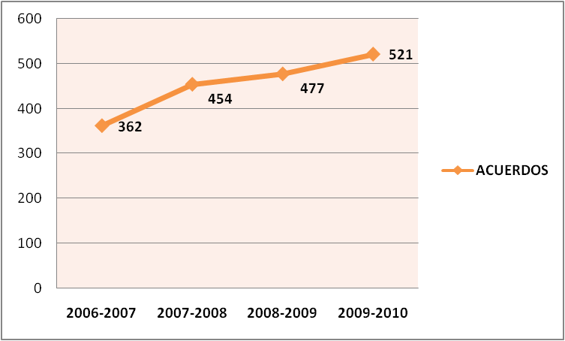
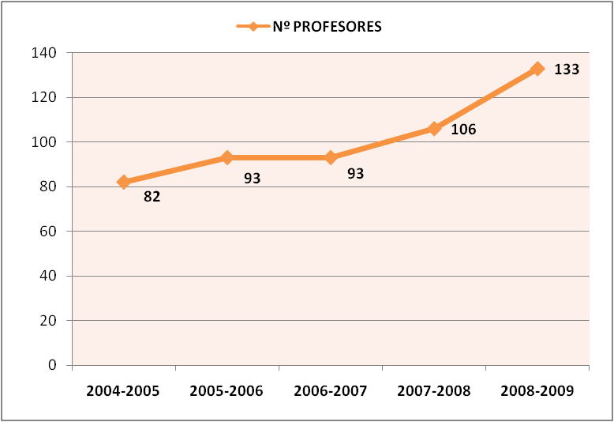
INTERNATIONALISATION IS A PRIORITY AT THE UNIVERSITY OF SEVILLE

