Slide 1
International Relations
Strategic Plan
Tempus Project ICAEN
Minsk, September 2012

Slide 2
Introduction
Structure of the Strategic Plan
Control Panel
Process-based Management
Evaluation

Slide 3
Introduction
Structure of the Strategic Plan
Control Panel
Management based on process
Evaluation

Slide 4
Globalization has forced universities
to promote their internationalisation process
as a way to improve competitiveness
REQUIREMENTS
International Relations Strategic Plan
Solid Structure
(International
Relations Office)

Slide 5
Strategic Plan for the University of Seville
Strategic Plan for International Relations
2008-2012

Slide 6
Key characteristics of the Strategic Plan
Flexibility: Plan is based on a modular structure that enables a faster response to major changing conditions
Continuity: The 5 year-duration of the Strategic Plan provides continuity as it does not coincide with the renewal of the Governing Board of the University of Seville
Change of Organizational Culture: gradually leading to management improvement
Process-based Management

Slide 7
USUAL MANAGEMENT MODEL | MANAGEMENT OF THE STRATEGIC PLAN
Role based | Process based
Task oriented | User oriented
Bueraucratic | Management
Presential Management | On line/virtual
Safe management | Excellence management
Scarce information | Information and communication
Reactions | Proactive management
Adapting | Innovating
Overcrowding/growth | Stability/quality
Distant from society | Close relationship with companies and institutions

Slide 8
Methodology
Setting up a Strategic Plan Office
Establishment and presentation of Guidelines
Participation and development
Viability study, debate and approval
Monitoring and control

Slide 9
Methodology
Setting up a Strategic Plan Office
Drafting methodological bases approved by the Governing Body of the University
Analysis of the competences, resources and framework of the University: SWOT (Strengths, Weaknesses, Opportunities, and Threats)

Slide 10
Methodology
Establishment and presentation of Guidelines
Collecting information available at the University
Drafting documents in order to frame further debates among university community members and social agents

Slide 11
Methodology
Participation and development
Fostering the participation and the communication with the University Community through the web page
Presenting the outcomes at the different Faculties and University Schools
Intersectoral Debate Groups (Teaching staff, Research staff, Institutional Relationships)

Slide 12
Methodology
Viability study, debate and approval
The structure viability is to be ensured checking following points:
How do the drafted strategic guidelines contribute to the mission, vision and general objectives established in the Strategic Plan?
How these objectives contribute to the strategic lines?
Are the drafted programs and actions able to achieve the established objectives?

Slide 13
Methodology
Monitoring and control
The Control Panel is set up to annualy review :
The achievement of the objetives
The level achieved according to indicators of the actions
Global assessment on the implementation and development of the Plan

Slide 14
Introduction
Structure of the Strategic Plan
Control Panel
Management based on process
Evaluation

Slide 15
Mission, vision and values
Strategic Lines
Strategic Objectives
Strategic Actions

Slide 16
Mission, vision and values
Mission
The organization’s reason for being
Who are we?
Future-oriented declaration of the organization’s purpose
What do we want to be?
Vision
Values
Beliefs and principles that determine our behavior
What do we believe in?

Slide 17
Mission, vision and values of international relations
Mission: to execute internationalization and cooperation and development policies as established by the Rector and the Governing Board of the University
Vision: become a model of excellence, bench mark and working tool for all university community members seeking the information, guidance and support necessary for the succesful completion of international activities
Values: expertise, commitment, welcoming environment and flexibility

Slide 18
Strategic lines
Key areas to acchieve the fulfillment of the mission statement
Institutional objectives are grouped in a consistent way

Slide 19
Strategic lines of the US
Excellence of the university as a learning and teaching centre
Most innovating techniques in frontline research and teaching activities
A university committed to their students’ aims
A modern and renewed university
A university committed to society
A university committed to solidarity and the environment

Slide 20
Strategic objectives
Are targets needed to be achieved to accomplish the vision
Must be related to one of the 6 strategic lines
Example:
Promoting mobility programs addressed to the university community members

Slide 21
Strategic actions
These are the steps to be taken in order to achieve the objectives
Must be consistent with the values and principles of the university
Example:
Promoting students mobility programs through scholarships

Slide 22
Strategic Plan March 2011
Unit | Code
International Relations | UN46
Strategic Line N. 1 | Excellence of the university as a learning and teaching centre
Objective N. 2 | Promote and encourage European Convergence In University Studies
Action N. 5 | Term (short/medium/long) | Responsible | Indicator | Target | Deadline date
-Foster cooperation with foreign institutions to consolidate double degrees | Medium | International Relations Service | Number of double degree agreements with foreign institutions Number of agreements with foreign institutions | 10 10% | 2011/2012

Slide 23
Introduction
Structure of the Strategic Plan
Control Panel
Management based on process
Evaluation

Slide 24
What is the use of a Control Panel ?
It is a management tool controlling compliance of the strategy set up by the government board of the university using the appropriate indicators
It supports quick and successful decision making in order to achieve the objectives set up in the Strategic Plan
It helps to communicate the strategy, align objectives, promote continous training and motivation to the staff and redesign strategy

Slide 25
Strategic Map of the US
Users and social responsability
Solidarity
(6)
Integration into the environ-ment (5)
Student training
(3)
Innovación y desarrollo
Innovation teaching e research (2)
Learning
(1)
Innovation and development
Modernization in management (4)
Management
Budget balance
Financial coverage
Financial efficiency
Funding

Slide 26
Guidelines
Innovation and development: indicates the knowledge and skills of the university
Funding: controls some aspects of the strategic plan but it is not considered a strategic line
Users and social responsability: measures user satisfaction
Management: measures the ability to respond appropriately to the needs of the university community

Slide 27
Indicators
They can measure strategic actions providing insight into the degree of compliance with the strategy
They must be: clear, accessible and relevant
They can be represented in absolute terms or as a ratio (relation in respect of size between two magnitudes)
Example:
Absolute indicator: number of students (50)
Ratio: number of students/teacher (50/2)

Slide 28
Control Panel of the US
It shows the indicators for the actions included in the Strategic Plan and the entity in charge of the control
GUIDELINE: users and social responsability OBJECTIVE 2: Support to multicultural integration
Line | Objective | Action | Indicator | Responsible
6 | 2 | 3 | Number of exchange students from other universities | Office of InternationalRelations

Slide 29
Control Panel of International Relations
It consists of an uncomplicated excel spreadsheet displaying the results of the indicators related to the actions included in the 4-year Strategic Plan
Action
Indicator
Calculation formula
Data required for calculating (4 years)
Results (4 years)
Target to achieve
Responsible for measurement and control
Areas

Slide 30
Introduction
Structure of the Strategic Plan
Control Panel
Management based on process
Evaluation

Slide 31
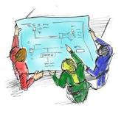
Process-based Management System
This is a form focused on key processes, to manage the actions and programs adopted by an organization, addressing the achievement of objectives established in its general strategy plan
Process identification
Process description
Measuring results
Evaluation
Map of process
Handbook of processes
Control Panel
Improvement Plan

Slide 32
Types of processes
Linked to the management team (strategig planning, quality..)
Strategic Processes
Directly influence the customer/user (Education, Funding)
Key or
operational Processes
They support key processes (financial management..)
Support Processes

Slide 33
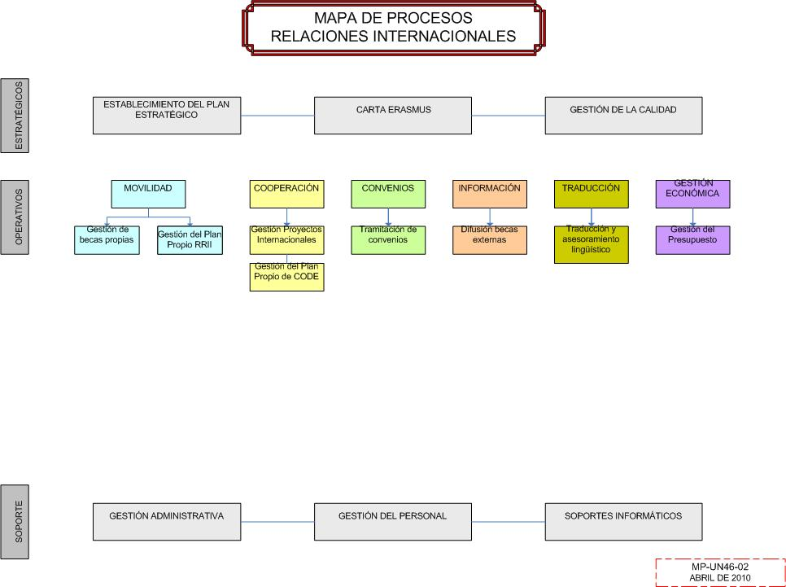

Slide 34
Process Handbook
It describes the procedures used to start every key single process
It guarantees the correct funcionting of the processes regardless of an eventual replacement of staff responsible for the tasks
It should include all the tasks included in the process, and specificies following:
The person or body responsible for the project
The approximate duration including execution date
All important facts (num. of applications, demands, grants awarded…)

Slide 35
Handbook of processes of International Relations
INTERNATIONAL PROJECT AREA
1.1. CALL FOR SCHOLARSHIP OF PIMA PROGRAM
1.1.1 To draft the public call for participation
1.1.2 To approve the public call
1.1.3 To publish the call
1.1.4 To approve the Selection Committee
1.1.5 To appoint the Committee members
1.1.6 To select candidates
1.1.7 To publish the Provisional decision
1.1.8 To solve claims
1.1.9 To publish the Final Decision
1.1.10 Official communication to selected candidates

Slide 36
Improvement Plan of International Relations
INTERNATIONAL PROJECT AREA
1.1. EXCHANGE PROGRAM PIMA GRANTS ANNOUCEMENTS
1.1.1 To approve the call (by june)
1.1.2 To estblish the amount of the scholarship according to the home country of the participants
1.2. GENERAL ASPECT
1.1.1 To hold monthly task coordination meetings
1.1.2 To increase the visibility of the approved projects

Slide 37
Incentive system
Staff incentives (bonus, promotion..) to motivate staff to achieve targets, according to progress reports

Slide 38
Introduction
Structure of the Strategic Plan
Control Panel
Management based on process
Evaluation

Slide 39
EFQM Evaluation Model
The European most widespread evaluation model is the EFQM, that uses several tools to achieve its results, including the PERFIL questionnaire
This model measures the results of an organization, unit or administrative service, comparing it with the standarts of an organizational model of excellence using a grading scale from 0 to 1000 points.
Parts:
Self-assessment
External Assessment

Slide 40
Basic concepts of organizations of excellence
Achieving balanced results
Adding value to customers/users
Encouraging creativity and innovation
Developing partnerships
Achieving success through people
Process-based Management
Commitments towards a sustainable future

Slide 41
Parts of the EFQM Evaluation Model
Self-assessment: carried out by the members of the organization, unit or administrative service
External Assessment: carried out by an External Evaluation Committee which checks and validates the Self-assessment Report
Self-assessment Report
External Assessment Report

Slide 42
Thank you for your attention
Rosario López Ruiz
Head of the Service of International Relations
and Cooperation
E-mail: relint1@us.es

