Slide 1
Presentation
of the
Haute Ecole Charlemagne
Notes:
My presentation will be in three parts:
First, The Hautes Ecoles in the French Community of belgium
Secondly The Haute Ecole Charlemagne
And for finish, a day in the international office

Slide 2
The « Hautes Ecoles » in the French Community of Belgium

Slide 3
HIGHER EDUCATION
3
UNIVERSITARY
ACADEMIES
70000 students
17
Art academies
7000 students
20
HAUTES ECOLES
75000 students
Notes:
Besides the Hautes Ecoles, other institutions can also be found:
- Universities with a full academic program including first-, second- and third-cycle studies
- the Art Schools: they offer long and short cycle studies in various areas linked to arts and are presently working with Universities on the creation of an Art PhD.

Slide 4
HAUTES ECOLES
BELGIUM
Higher Education Institutions
Notes:
Over than 15 years ago, legislation was passed in Belgium which created a new type of education institution, called “Haute Ecole” in French and which can be loosely translated in English as ‘University colleges”.

Slide 5
A vocational programme
PLACEMENTS
TEACHERS
+
PROFESSIONALS
Notes:
The Hautes Ecoles provide a technical or vocational short or long programme (“type court”, in French), which is composed of a single three-year cycle or a five-year cycle, and which brings the students directly to a profession.
Whatever the choice, the programmes offered by the Hautes Ecoles always include long periods of work placement equivalent to at least half a year, which prepare the student to professional life.
Indeed all these programmes aim at developing professional skills and directly lead to a particular specialized activity.
The staff of the Haute Ecoles is always composed of both full-time teachers and relevant professionals .

Slide 6
First cycle: 3 years (Bachelor) (180 ECTS) + Second cycle: 1 or 2 years (Master) (60 or 120 ECTS)
UNIVERSITY PROGRAMME
(4 or 5 year)
Notes:
The Hautes Ecoles provide two types of study:
An education programme at University level called “type long” in French (or graduate programme) which in fact means that it is a 5-year programme divided into 2 cycles:
- a three-year transition First cycle (Bachelor)
- mostly a two-year Second cycle (Master)
The main difference with Universities lies in a closer link with the various professions in which the students of the Hautes Ecoles are trained, but the level is absolutely equivalent to that offered by the Universities.

Slide 7
The Haute Ecole Charlemagne

Slide 8
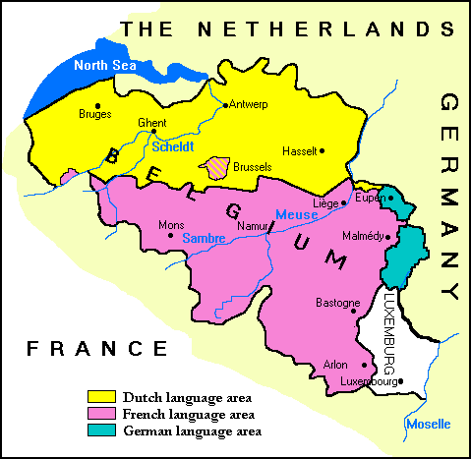
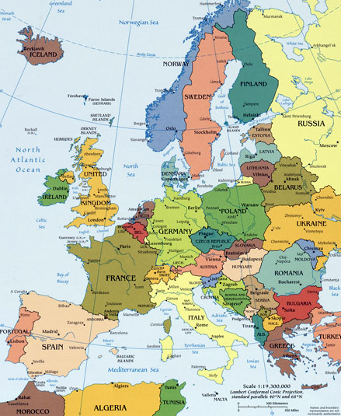
Notes:
Europe
Belgium
Liège, part of the French community
Liege has a strategic position close to The Netherlands, Germany and France
In Liège, we have airport, fast train, river harbour,
We are forty minutes from Brussels, two hours from Paris, Amsterdam , Francfort, London, etc…

Slide 9
The Haute Ecole Charlemagne
The Haute Ecole Charlemagne (HECh) proposes higher education programmes organised by the French Community of Belgium.
HECh is a partner of the University of Liège

Slide 10
The Haute Ecole Charlemagne
HECh headquarter is located in Liège - Belgium; additional campuses are also located in Gembloux, Huy & Verviers.
The students number reaches 2,900, the fulltime professor’s 230 and the administration’s 30.

Slide 11
The Haute Ecole Charlemagne
The degrees delivered are bachelors (3 yrs – 180 ECTS) and masters (2 yrs – 120 ECTS)

Slide 12
The Haute Ecole Charlemagne
The curricula offered deal with several departments: agriculture (agronomy & horticulture engineering, environment, food industry & landscape architecture), economics (logistics, tourism, secretarial, hotel management), paramedical, teacher training (nursery, primary, secondary, youth workers) and technical (packaging).

Slide 13
The Haute Ecole Charlemagne
In addition the teacher training department offers several specialised trainings for adults (Education Centre Related to Health – Environment Interactions (CERISE), in collaboration with the European Social Fund).

Slide 14
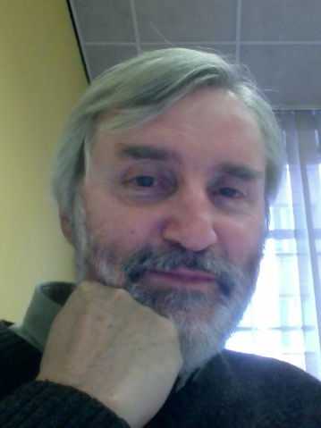
The Office for International Relations
Jean Chapelle,
Institutionnal coordinator,
who greets all of you,
Dominique Pairoux,
administrative assistant
Notes:
And now the office for International Relations, located in Liège headquarter, depending directly to the Presidence.

Slide 15
The Office for International Relations
Erasmus program:
Bilateral agreements
Out-going students
In-coming students
Administrative and financial management
HECh international policy
Notes:
The Erasmus program
with the search, signature, modification of the BA
with the application, selection, support for out-going students (before, during and after their mobility)
With the welcome and support for In-coming students (before and during their mobilty)
represents the most important of our job,

Slide 16
The Office for International Relations
A day at the office:
e-mails
Scheduled
Visit of the students OG and IC
Depending on the period
Notes:
Everyday, we begin to read all the e-mails (one e-maill adress, relinter@hech.be, accessible for both ) and decide who does what
We receive a lot of students for informations about the Erasmus program

Slide 17
The Office for International Relations
Bilateral agreements
Search
Signature
Modifications
Notes:
Search: mostly proposed by the students, sometimes by the teachers; search for adhoc partners institutions (trough Internet), check program compatibility, make e-mail contact, negocation, possible visit
Signature by the President
Modifications: if wanted by one party (for example: extension of domains, number of students, …)
Possible withdrawal

Slide 18
The Office for International Relations
Out-going students: SMS - SMP
General informations
Individual information
Application
Contractual procedures
Contact during the stay
TOR
Back—debriefing
Notes:
Student Mobility for Studies – Student Mobility for Placement
In classrooms, general informations about the Erasmus program and specific destinations
In the OIR, the students receive informations about their specific questions
Application: reception, selection by the departments
Contractual procedures: grant contract and ECTS learning agreement
Contact during the stay: by e-mail, about the stay, modifications to the ECTS learning agreement, various issues
Transcript of records: sended by the host universty, translation of the ECTS TOR into HECh report, transfer to the departmental jury
Back-debreifing: reading of the individual rapport, specific comments on request

Slide 19
The Office for International Relations
In-Coming students:
Before
During
After
Notes:
Before: reception the application sending by the OIR partners, transfer the student’s file to our departments, welcome e-mail to the IC-students with recommandations and contact with HECh’s student in charge of welcome and support, Free preparatory French intensive week
During: welcome day with the ULg (city tour with usefull links and spots), ECTS learning contract in touch with departments (sent to the home university for acceptance), Free French language course compulsory organised by the IOR
Welcome by students and language courses are best practice organised with the collaboration of our students from tourism and from French language as foreign language,
After: TOR are established, signed and sent to the OIR partners also differrent attestations.

Slide 20
The Office for International Relations
Administrative and financial management
Notes:
Administrative management: management for each student (OG, IC), for each professor (OG, IC), calculation of the grant, transfer order, administrative final reports
Financial management: financial reports

Slide 21
Thank you
for your attention

