Slide 1
Tempus Project TEMPUS-SMGR 516663-TEMPUS-1-2011-ES
Internationalization in Central Asia and the Eastern Neighbouring Area
(ICAEN)
http://institucional.us.es/tempusicaen/

Slide 2
Project Summary
ICAEN project aims at strenghtening capacities for international cooperation in countries of the Eastern Neighbouring Area and Central Asia in order to contribute to better international networking & exploitation of institutional & national internationalization potentials in the involved regions. Specifically, the project aims at systematic analysis & benchmarking of potentials and development of national recommendations for boosting internationalisation of Teaching, Learning & Research in Belarus, Georgia & Tajikistan. The action further foresees strenghtening of strategic, infrastructural & human capacities in 6 universities as a model for the development & modernisation of institutional management of internationalisation in the three Partner Countries. At the core of the project also lies the development of an international network as a platform for regular dialogue & exploitation of synergies in internationalisation in a multi-regional context. The specific objectives will be realised through carefully planned actions at institutional, national & multi-regional levels including: implementation of a set of comprehensive strategic and managerial trainings & infrastructural measures at the level of the institutions involved; benchmarking exercises & development of national recommendations for boosting research & internationalisation potentials in Teaching/Learning, development of best-practice manuals for Higher Education Institutions on how to improve their policies & management of International Relations. The action is complemented by extensive dissemination & networking activities including national roundtables & international network conferences. The partnership comprises 14 institutions including four EU universities with varied and extensive experience in internationalisation, 6 partner country universities representing various challenges in the process of shaping internationalisation strategies, students organizations & Ministries of Education.

Slide 3
SPECIFIC OBJECTIVES
1. Benchmarking & identification of potentials and development of national recommendations for internationalisation of teaching, learning & research in 3 partner countries of the Eastern Neighbouring Area & Central Asia by 2013
2. Enhancement of structural & human capacities for the development and implementation of policies and structures for international relations in 6 universities in Belarus, Georgia and Tajikistan by 2014;
3. Development of a multi-regional network for a structured dialogue on internationalisation and promotion of multi-lateral cooperation in Higher Education in BE-GE-TJ by Oct. 2014

Slide 4
REQUIREMENTS NECESSARY FOR INTERNATIONALIZATION OF HEIs
National Legal framework supportive of internationalization
-Comprehensive legal framework at the Ministry of Education
-Fostering competition among universities
-Recognition (incentives) for professors and staff to foster internationalization
-Recognition of studies done abroad
-Possibility of forcing national/international mobility as a requisite for promotion of staff
-Measures to increase reception of foreign students and professors (for instance, relaxing of visa requirements)
National Budget supporting internationalization (eg, grants at the Government level like those of the Campus of Excellence)
-Tax benefits to donors supporting universities

Slide 5
OUTCOMES AS PLANNED IN APPLICATION
1. Policy & Strategic Planning of Internationalization in HEIs
2. Human Capacity Building - International Relations Staff
3. Dev. of Potentials for Internationalization in Teaching/Learning/Research
4. Infrastructural Measures
5. Multi-Regional Network for Internationalization
6. Dissemination
7. Sustainability
8. Quality Control Plan
9. Project Management

Slide 6
CURRENT STAGE IN IMPLEMENTATION OF PROJECT
Preliminary Training is going on well
Offices of International Relations being improved
Web page & Intranet of the Project Developed
Language Training will start soon. Change in schedule, first live, then on line.
Equipment currently being purchased

Slide 7
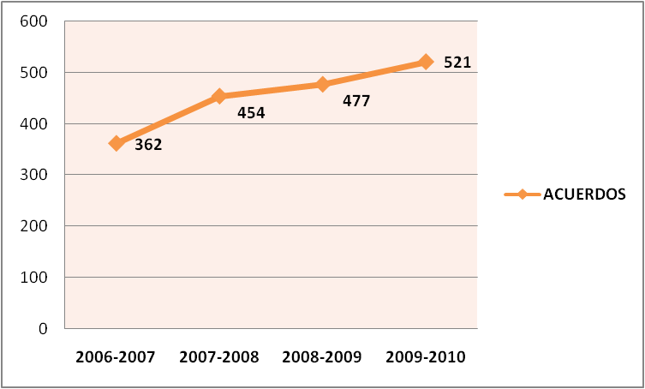
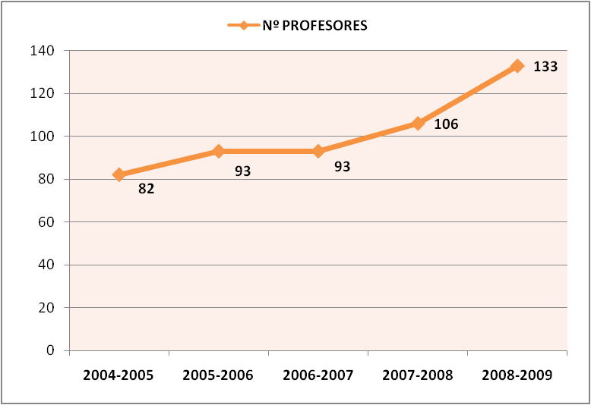
INTERNATIONALISATION IS A PRIORITY AT THE UNIVERSITY OF SEVILLE

